Slide 1

Get Started with Azure Key Vault
Mihai Petrica
AND
Taswar Bhatti (Microsoft MVP)
November 2017

Slide 2

Gemalto

Slide 3
Azure Key Vault
What are we trying to solve with Key Vault?
Let’s step back and look at a Cloud Design Pattern
External Configuration Pattern

Slide 4

External Configuration Pattern

Slide 5
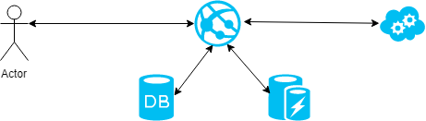
Typical Application

Slide 6
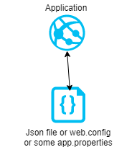
Storing Configuration in file

Slide 7
Multiple application

Slide 8
External Configuration Pattern
Helps move configuration information out of the application deployment
This pattern can provide for easier management and control of configuration data
For sharing configuration data across applications and other application instances

Slide 9
Problems
Configuration becomes part of deployment
Multiple applications share the same configuration
Hard to have access control over the configuration

Slide 10
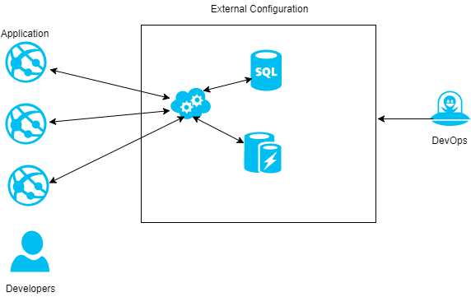
External Configuration Pattern

Slide 11
When to use the pattern
When you have shared configuration, multiple application
You want to manage configuration centrally by DevOps
Provide audit for each configuration

Slide 12

When not to use
When you only have a single application there is no need to use this pattern it will make things more complex

Slide 13
Cloud Solution Offerings
Azure Key Vault (Today’s Talk)
Vault by Hashicorp
AWS KMS
Keywhiz

Slide 14
What is Azure Key Vault ?
Safeguard cryptographic keys and secrets used by cloud applications and services
Use hardware security modules (HSMs)
Simplify and automate tasks for SSL/TLS certificates

Slide 15
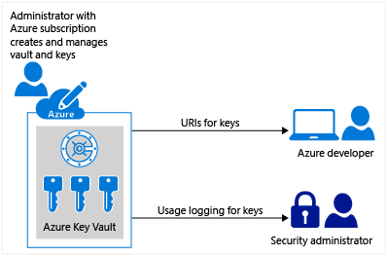

Slide 16
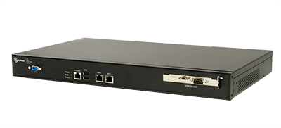
Gemalto / SafeNet – Hardware Security Module

Slide 17
How Azure Key Vault can help you ?
Customers can import their own keys into Azure, and manage them
Keys are stored in a vault and invoked by URI when needed
Key Vault performs cryptographic operations on behalf of the application
The application does not see the customers’ keys
Key Vault is designed so that Microsoft does not see or extract your keys
Near real-time logging of key usage

Slide 18
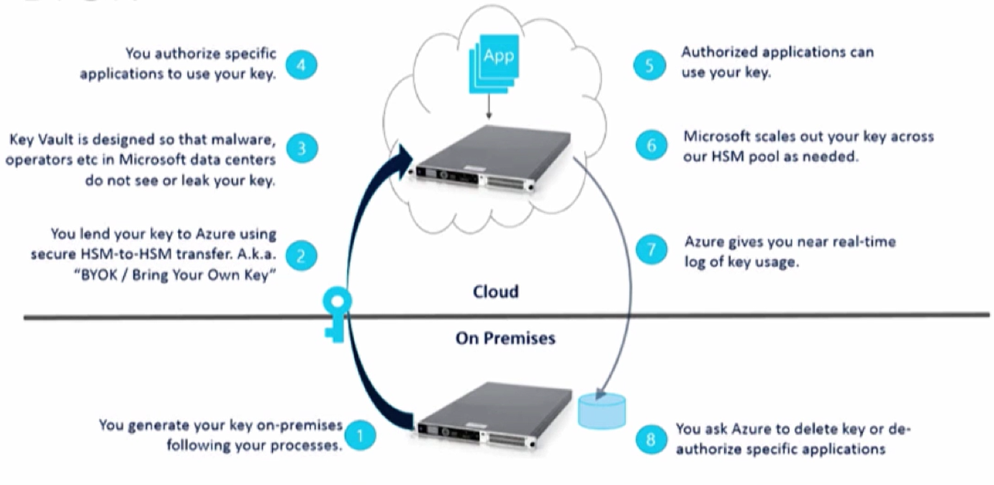
Bring Your Own Key (BYOK)

Slide 19
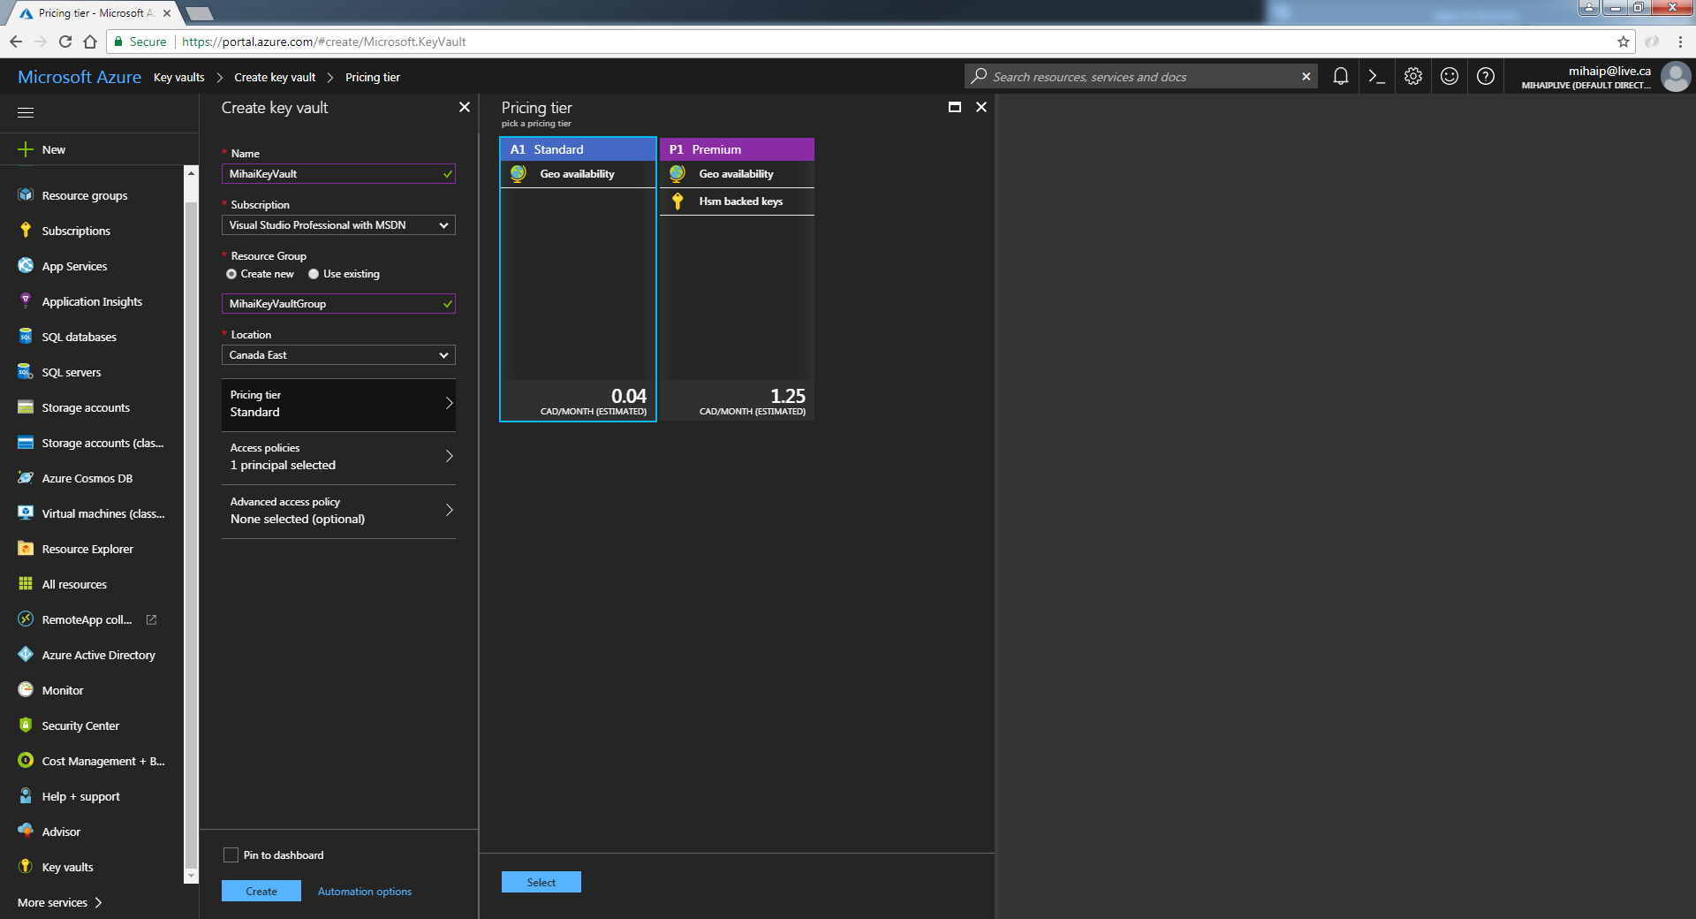
Create a Key Vault
New-AzureRmKeyVault -VaultName ‘MihaiKeyVault' -ResourceGroupName ‘MihaiResourceGroup' -Location 'Canada East'

Slide 20
Objects, identifiers, and versioning
Objects stored in Azure Key Vault (keys, secrets, certificates) retain versions whenever a new instance of an object is created, and each version has a unique identifier and URL
https://{keyvault-name}.vault.azure.net/{object-type}/{object-name}/{object-version}

Slide 21
Azure Key Vault keys
Cryptographic keys in Azure Key Vault are represented as JSON Web Key [JWK] objects
RSA: A 2048-bit RSA key. This is a "soft" key, which is processed in software by Key Vault but is stored encrypted at rest using a system key that is in an HSM
RSA-HSM: An RSA key that is processed in an HSM
https://myvault.vault.azure.net/keys/mykey/abcdea84815e4ca8bc19cf8eb943ee88

Slide 22
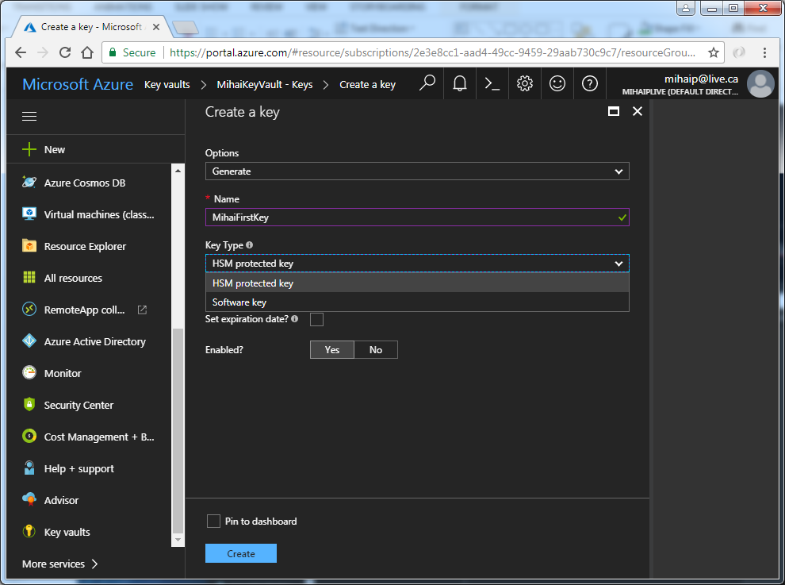
Create a Key Vault key
$key = Add-AzureKeyVaultKey -VaultName ‘MihaiKeyVault' -Name ‘MihaiFirstKey' -Destination 'Software'

Slide 23
Azure Key Vault secrets
Secrets are octet sequences with a maximum size of 25k bytes each
The Azure Key Vault service does not provide any semantics for secrets; it accepts the data, encrypts and stores it, returning a secret identifier, “id”, that may be used to retrieve the secret
https://myvault.vault.azure.net/secrets/mysecret/abcdea54614e4ca7ge14cf2eb943ab23

Slide 24
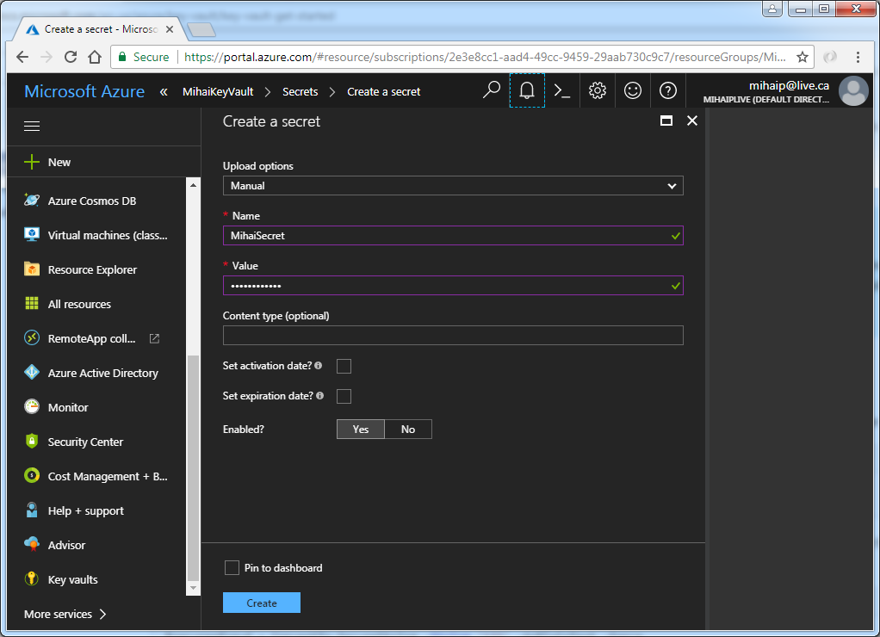
Create a Key Vault secret
$secret = Set-AzureKeyVaultSecret -VaultName ‘MihaiKeyVault' -Name 'SQLPassword' -SecretValue $secretvalue

Slide 25
Azure Key Vault certificates
Import/generate existing certificates, self-signed or Enroll from Public Certificate Authority (DigiCert, GlobalSign and WoSign)
When a Key Vault certificate is created, an addressable key and secret are also created with the same name
https://myvault.vault.azure.net/certificates/mycertificate/abcdea84815e4ca8bc19cf8eb943bb45

Slide 26
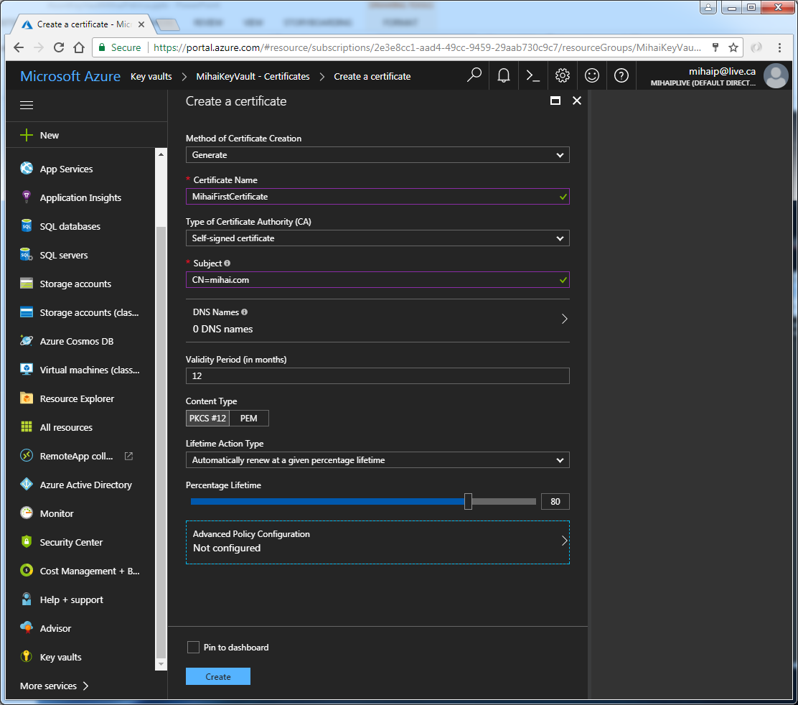
Create a Key Vault certificate

Slide 27
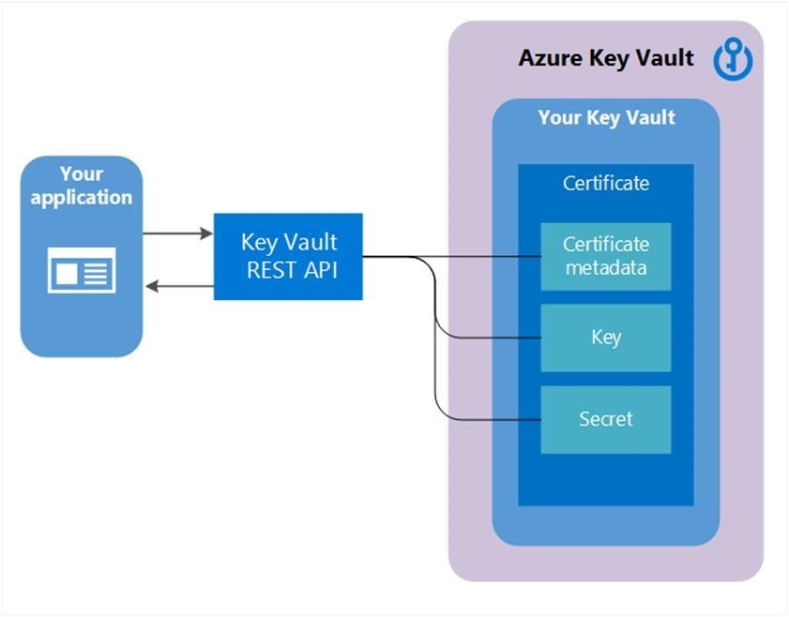

Slide 28
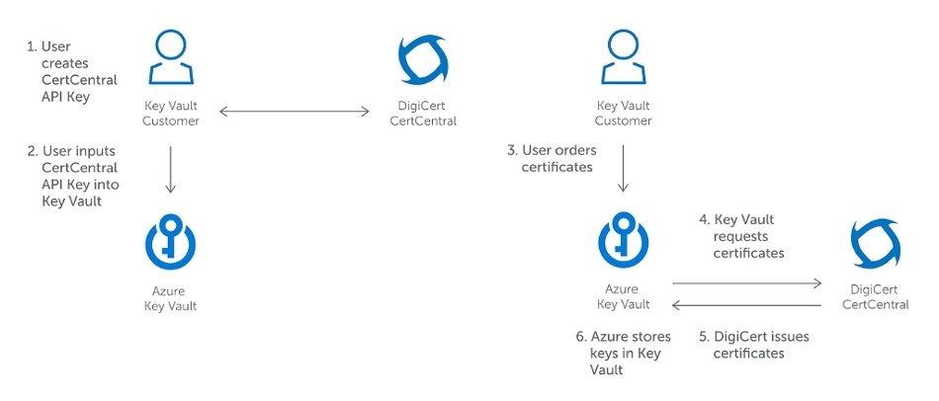

Slide 29
Secure your Key Vault
Access to a key vault is controlled through two separate interfaces: management plane and data plane
Authentication establishes the identity of the caller
Authorization determines what operations the caller is allowed to perform
For authentication both management plane and data plane use Azure Active Directory
For authorization, management plane uses role-based access control (RBAC) while data plane uses key vault access policy

Slide 30
Access Control
Access Control based on Azure AD
Access assigned at the Vault level
- permissions to keys
- permissions to secrets
Authentication against Azure AD
- application ID and key
- application ID and certificate

Slide 31
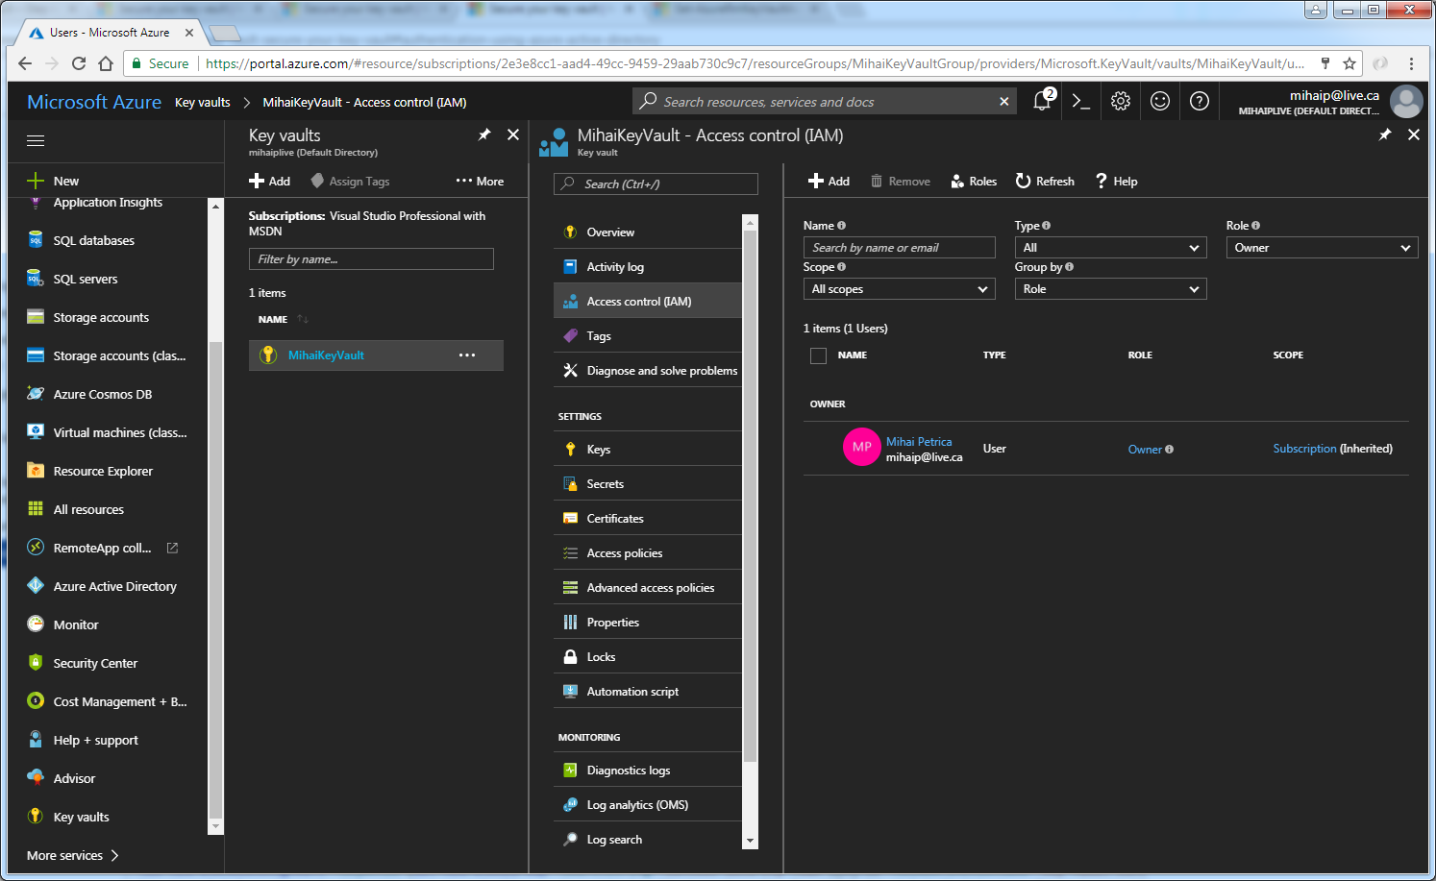

Slide 32
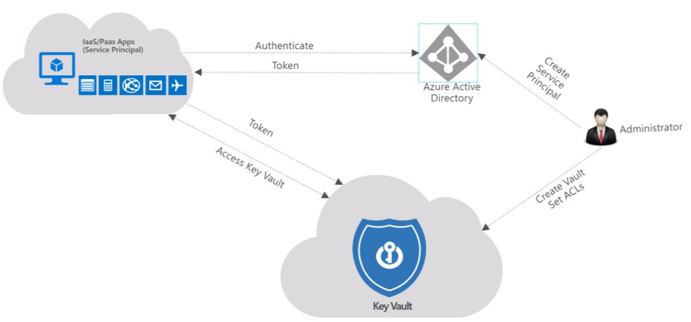

Slide 33
Azure Managed Service Identity (MSI)
Manage the credentials that need to be in your code for authenticating to cloud services
Azure Key Vault provides a way to securely store credentials and other keys and secrets, but your code needs to authenticate to Key Vault to retrieve them
Managed Service Identity (MSI) makes solving this problem simpler by giving Azure services an automatically managed identity in Azure Active Directory (Azure AD)
You can use this identity to authenticate to any service that supports Azure AD authentication, including Key Vault, without having any credentials in your code

Slide 34
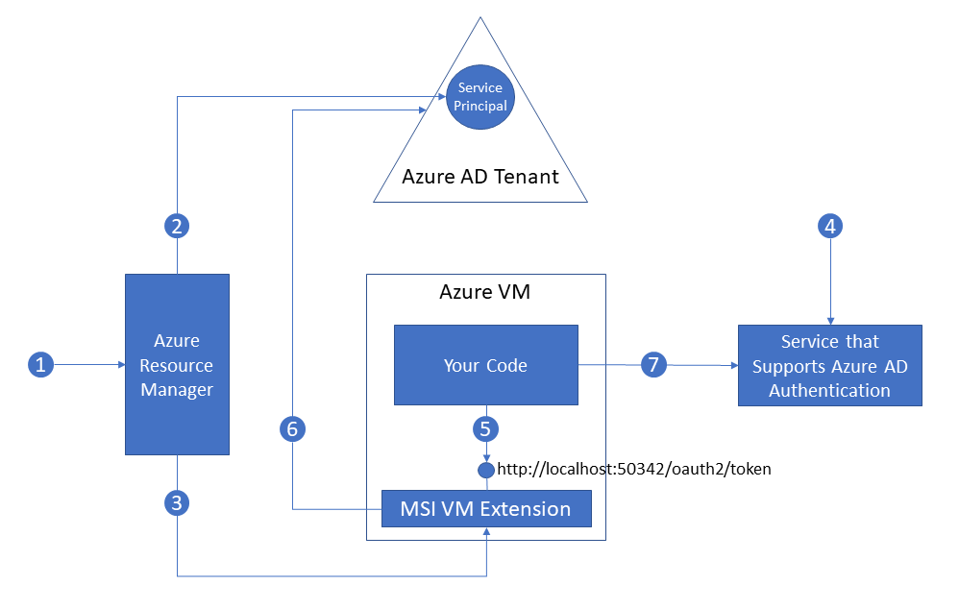

Slide 35
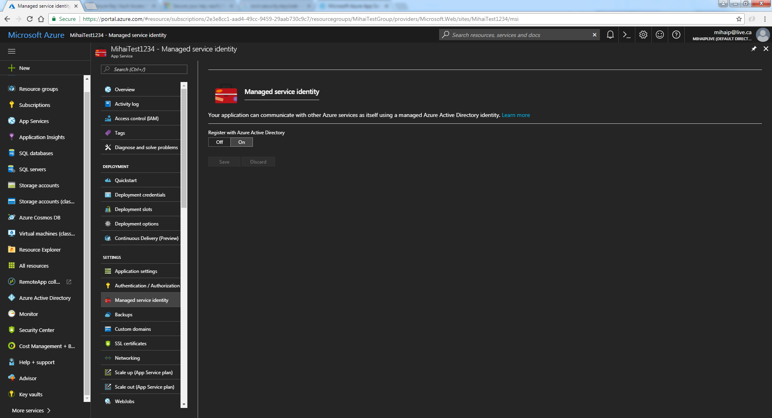

Slide 36
Azure Key Vault Logging
Monitor how and when your key vaults are accessed, and by whom
Save information in an Azure storage account that you provide
Use standard Azure access control methods to secure your logs by restricting who can access them
Delete logs that you no longer want to keep in your storage account

Slide 37
Azure Key Vault Pricing
Operations (Standard or Premium) $0.030 per 10000 operations
Advanced Operations (Standard or Premium) $0.150 per 10000 operations
Certificate Renewals (Standard or Premium) $3.00 per renewal
Hardware Security Module Protected Keys (Premium only) $1.00 per key

Slide 38
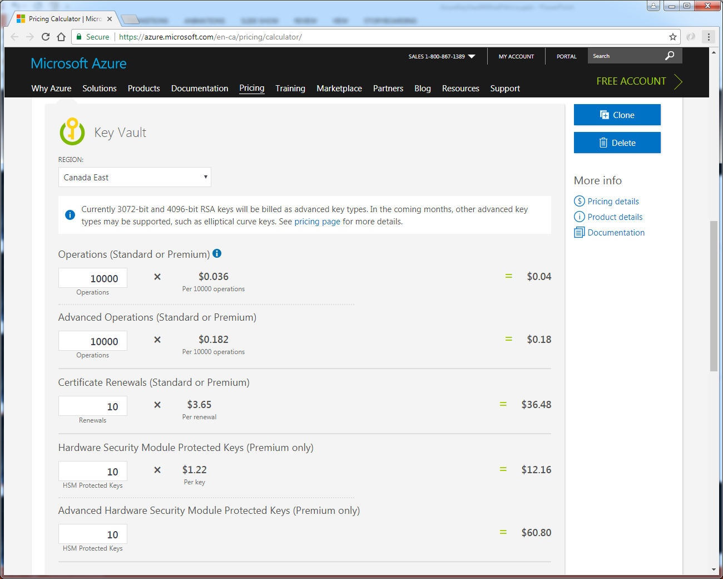

Slide 39
Azure Key Vault DEMO
Create Key Vault, Secrets, Keys and Certificates
Create Azure AD Application
Consuming Secrets and Keys
https://azurekeyvaultnet.azurewebsites.net - live demo
https://github.com/mihaipetri/AzureKeyVaultNet - demo code

Slide 40
Questions & Thank You
Mihai Petrica
Microsoft Certified Solutions Developer
Microsoft Certified Solutions Expert
mihaipetri@gmail.com
https://www.petrica.tech
https://github.com/mihaipetri/AzureKeyVault
Taswar Bhatti
Microsoft MVP
taswar@gmail.com
http://taswar.zeytinsoft.com

